Slide 1

Predicting Vintage Vinyl Resale Prices

Slide 2
Agenda
Motivation
Data
& Features
Eda and model selection
Findings

Slide 3
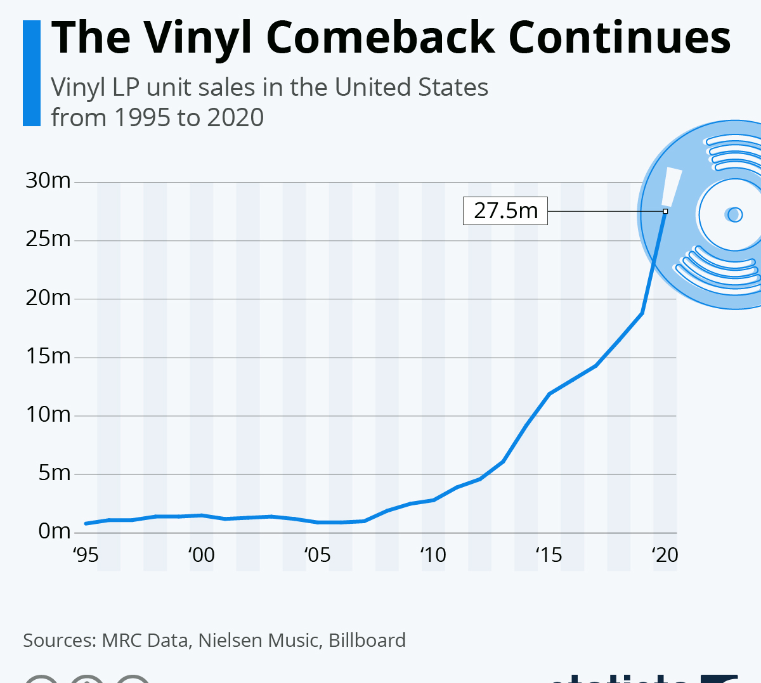
Motivation
10% increase in vinyl sales every year for past 15 years
26% of physical sales of recorded music (new records)
New vinyl prices increased by 490% between 2007 and 2017

Slide 4


Motivation
Record Shop A = $25
Record Shop B = $45

Slide 5

Goal
Help buyers and sellers estimate a target price for Vintage Jazz Vinyl
Better understand important features that impact the resale price

Slide 6

Data Collection and Features

Slide 7

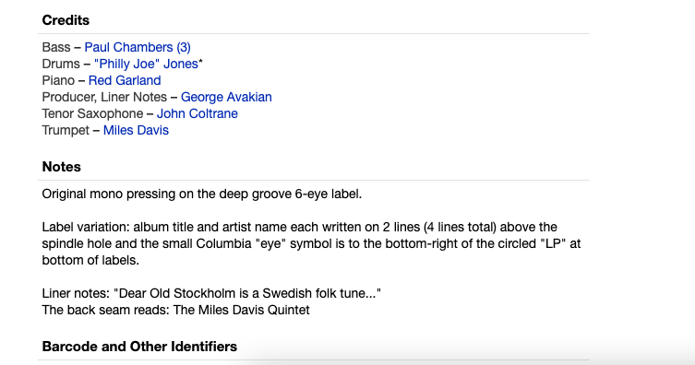
Data Source:
Genre: Jazz
Price: $20+
Release Year: 1950-1970

Slide 8
Features
Album
Record Label
Album Ratings
Artist
Price
Seller Rating
Wants
Haves
~15 Features
~8,000 Records
Release Date
Media Grade
Sleeve Grade
Notes

Slide 9

EDA & Model Selection

Slide 10
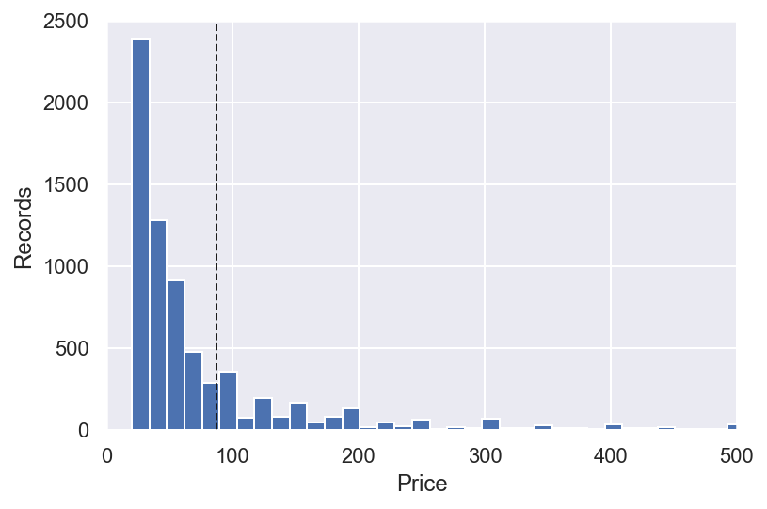
EDA – Resale Price
Mean = $87.37
Median = $45.00
Min = $20.00
Max = $2,800

Slide 11
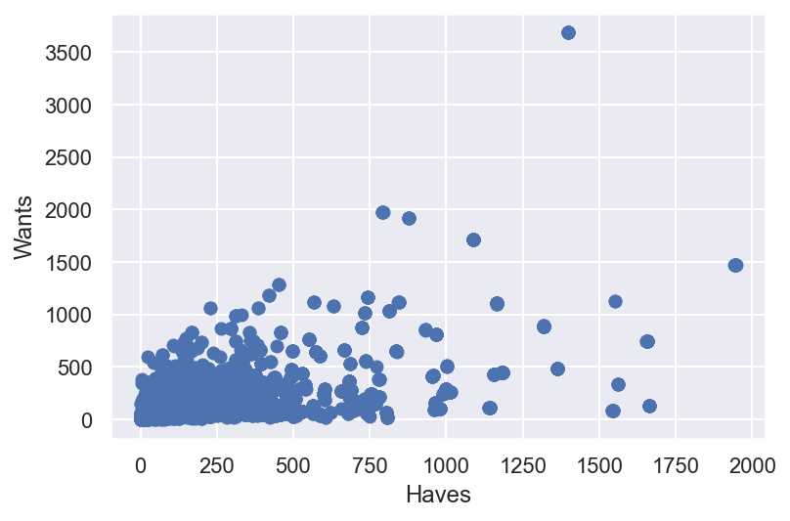
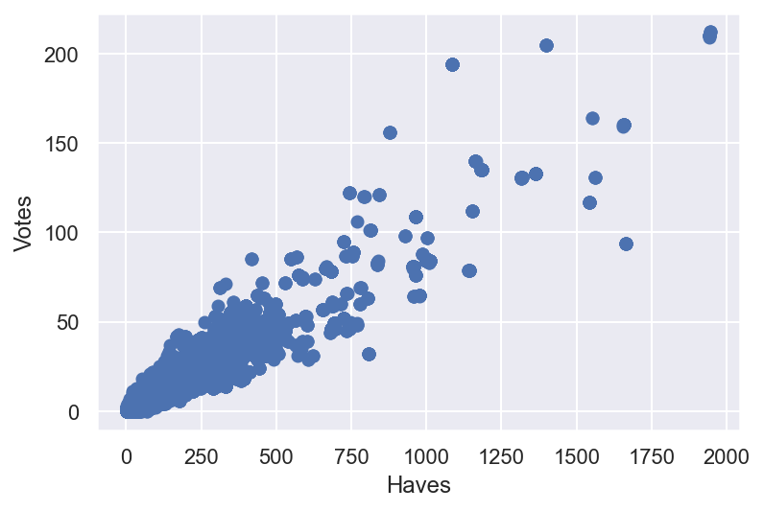
EDA – Feature Collinearity
Haves by Wants
Haves by Number of Ratings

Slide 12
Feature Selection (OLS)
Features Reconsidered
Notes: Keywords, mostly noise
Haves: Collinear with votes
Seller Rating: Majority of ratings were at or near 100%

Slide 13
Features
Album
Record Label
Album Ratings
Artist
Price
Seller Rating
Wants
Haves
~15 Features
~8,000 Records
Release Date
Media Grade
Sleeve Grade
Notes

Slide 14
Features Selection
Record Label
Album Ratings
Created Dummies for Record Label
Created a Wants to Haves ratio as weight
Price
Wants
Haves
Release Date
Media Grade
Sleeve Grade

Slide 15
Modeling Methods
Type | R^2 | MAE | RMSE
OLS | 0.233 | $59.15 | $112.16
Linear Regression Poly, Int, Stand | 0.462 | $50.68 | $110.72
Lasso CV, Poly, Int, Stand | 0.464 | $48.58 | $128.29
Ridge CV, Poly, Int, Stand | 0.469 | $48.70 | $123.59
TEST SET Ridge CV, Poly, Int, Stand | 0.377 | $50.80 | $110.24

Slide 16
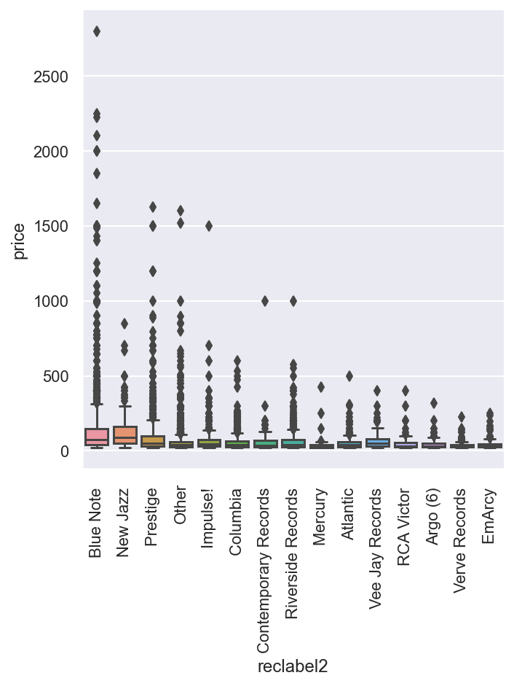
Key Features Based on Model Coefficients
Blue Note Records
Media Grade
Number of Wants
Seller Notes not helpful

Slide 17
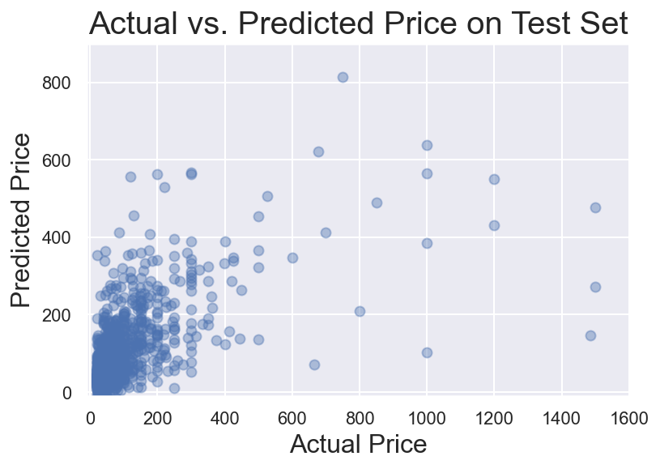
Results

Slide 18
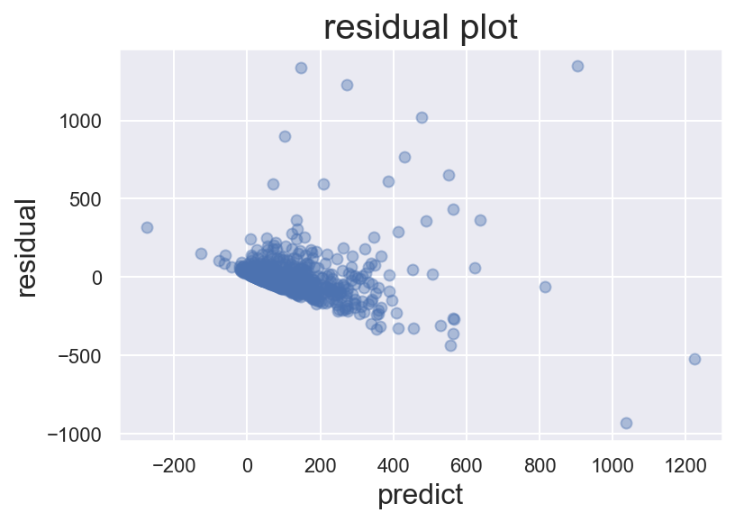
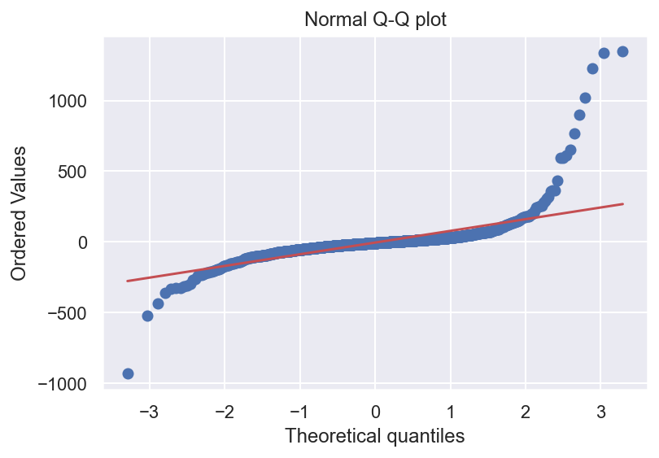
Residual and QQ plots

Slide 19

Future Improvements

Slide 20
Future Improvements
Transform Price to a log scale
Search more key-words in Notes section
Add data from e-bay
Weight albums by how frequent in market

Slide 21
Thank you!

Slide 22
Appendix

Slide 23
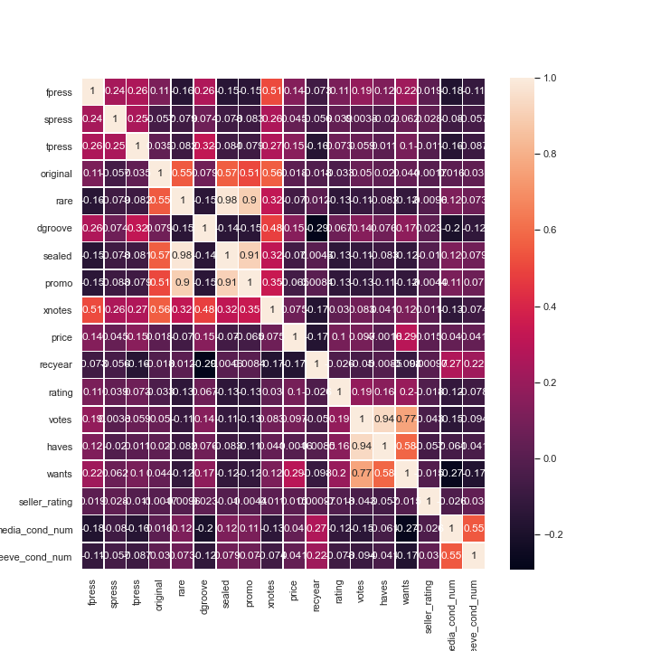
Correlation Heatmap

Slide 24
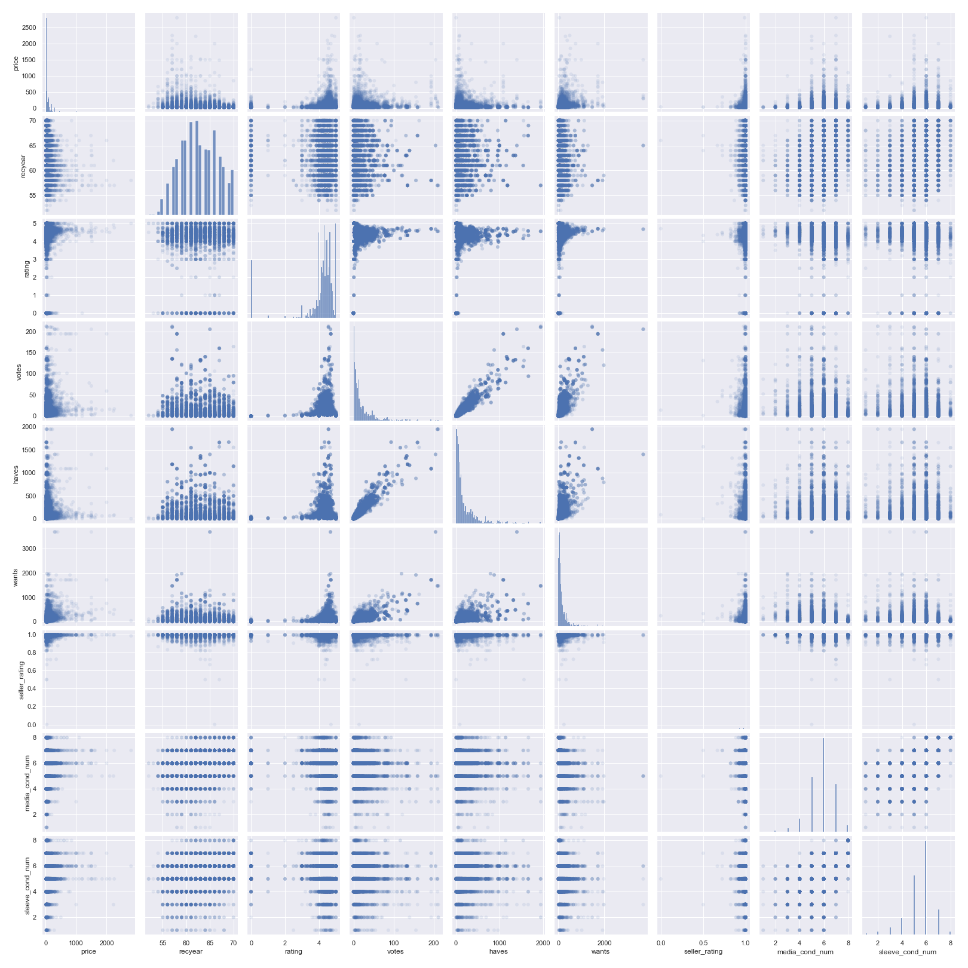
Pair Plots

Slide 25
Key Model Coeffecients – From TEST model (RIDGE CV)
Interactions | coeffs
'recyear reclabel2_Blue Note ' | -287.159
'recyear reclabel2_Columbia ' | 95.294
'media_cond_num reclabel2_Blue Note ' | 116.075
'wants media_cond_num' | 142.006

Slide 26
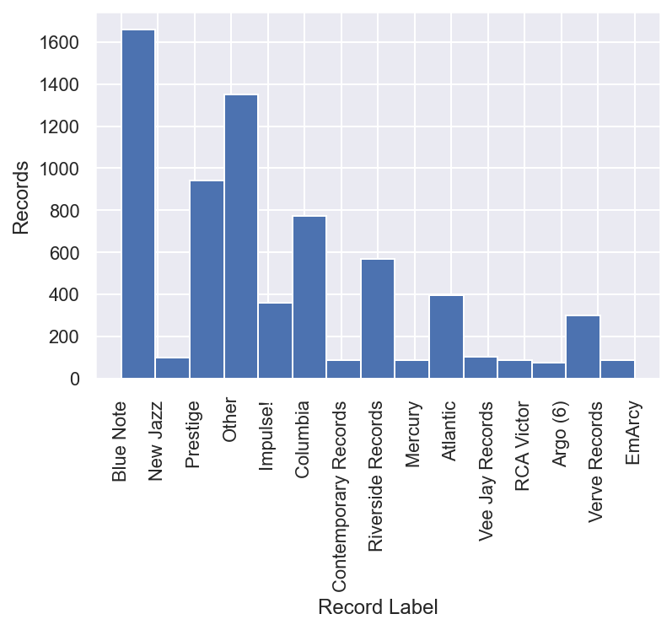
EDA – Record Labels

Slide 27
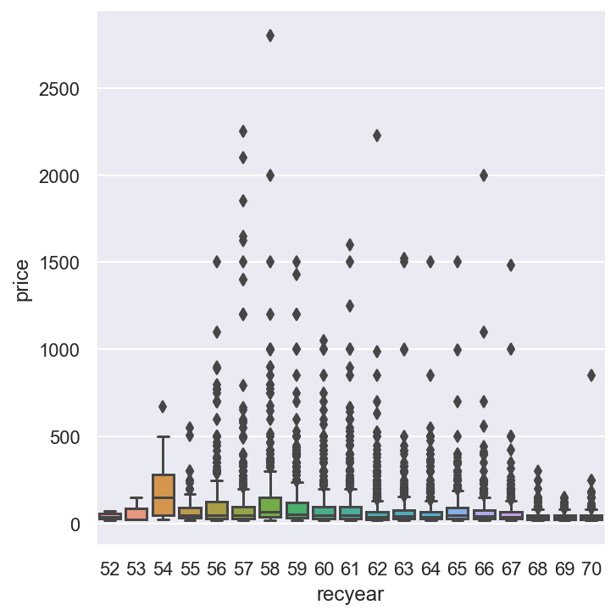
EDA – Release Year

